Slide 1

Accounting Principles
Thirteenth Edition
Weygandt Kimmel Kieso
Chapter 3
Adjusting the Accounts
Prepared by
Coby Harmon
University of California, Santa Barbara
Westmont College

Slide 2
Chapter 3
Adjusting the Accounts

Slide 3
Chapter Outline
Learning Objectives
LO 1 Explain the accrual basis of accounting and the reasons for adjusting entries.
LO 2 Prepare adjusting entries for deferrals.
LO 3 Prepare adjusting entries for accruals.
LO 4 Describe the nature and purpose of an adjusted trial balance.

Slide 4
Accrual-Basis and Adjusting Entries
Accountants divide the economic life of a business into artificial time periods (Time Period Assumption).
. . . . .
Jan.
Feb.
Mar.
Apr.
Dec.
Generally a
month,
quarter, or
year.
ALTERNATIVE TERMINOLOGY
The time period assumption
is also called the
periodicity assumption.
LO 1

Slide 5
Fiscal and Calendar Years
Monthly and quarterly time periods are called interim periods
Most large companies must prepare both quarterly and annual financial statements
Fiscal Year = Accounting time period that is one year in length
Calendar Year = January 1 to December 31
LO 1

Slide 6
Accrual- versus Cash-Basis Accounting
Accrual-Basis Accounting
Transactions recorded in the periods in which the events occur
Companies recognize revenues when they perform services (rather than when they receive cash)
Expenses are recognized when incurred (rather than when paid)
In accordance with International Financial Reporting Standards (IFRS)
LO 1

Slide 7
Accrual- versus Cash-Basis Accounting
Cash-Basis Accounting
Revenues recognized when cash is received
Expenses recognized when cash is paid
Cash-basis accounting is not in accordance with International Financial Reporting Standards (IFRS)
LO 1

Slide 8
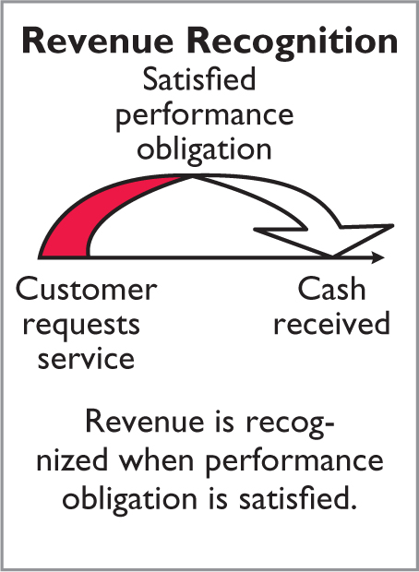
Recognizing Revenues and Expenses
Revenue Recognition Principle
Recognize revenue in the
accounting period in which the performance obligation is
satisfied.
LO 1

Slide 9
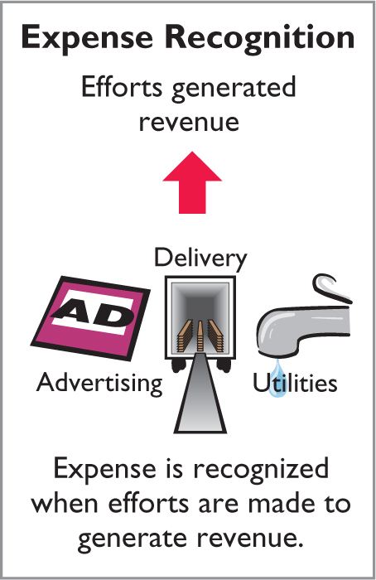
Recognizing Revenues and Expenses
Expense Recognition Principle
Companies recognize expenses in the period in which they make eﬀorts (consume assets or incur liabilities) to generate revenue.
“Let the expenses follow the revenues.”
LO 1

Slide 10
Time Period Assumption
ILLUSTRATION 3.1
IFRS relationships in
revenue and expense recognition
Economic life of business can be divided into artificial time periods.
Revenue Recognition
Principle
Expense Recognition
Principle
Recognize revenue in the
accounting period in which the
performance obligation is satisfied.
Recognize expense in the period that efforts are made to generate revenue.
Revenue and Expense
Recognition
In accordance with
International Financial
Reporting Standards (IFRS).
LO 1

Slide 11
The Need for Adjusting Entries
Adjusting Entries
Ensure that the revenue recognition and expense recognition principles are followed.
Necessary because the trial balance may not contain up-to-date and complete data.
Required every time a company prepares financial statements.
Will include one income statement account and one statement of financial position account.
LO 1

Slide 12
Types of Adjusting Entries
Deferrals
Accruals
1. Prepaid Expenses. Expenses paid in cash before they are used or consumed.
1. Accrued Revenues. Revenues for services performed but not yet received in cash or recorded.
2. Unearned Revenues.
Cash received before services are performed.
2. Accrued Expenses. Expenses incurred but not yet paid in cash or recorded.
ILLUSTRATION 3.2
Categories of adjusting entries
LO 1

Slide 13
DO IT! 1 Timing Concepts
Below is a list of timing concepts in the left column, with a description of the concept in the right column. There are more descriptions provided than concepts. Match the description to the concept
Monthly and quarterly time periods.
Efforts (expenses) should be recognized in the period in which a company uses assets or incurs liabilities to generate results (revenues).
Accountants divide the economic life of a business into artiﬁcial time periods.
Companies record revenues when they receive cash and record expenses when they pay out cash.
An accounting time period that starts on January 1 and ends on December 31.
Companies record transactions in the period in which the events occur.
1. ___ Accrual-basis accounting.
2. ___ Calendar year.
3. ___ Time period assumption.
4. ___ Expense recognition principle.
f
e
c
b
LO 1

Slide 14
Adjusting Entries for Deferrals
Deferrals are expenses or revenues that are recognized at a date later than the point when cash was originally exchanged. There are two types:
Prepaid expenses
Unearned revenues
Analyze
Journalize
Post
Trial Balance
Journalize and post adjusting entries: deferrals/accruals
Adjusted Trial Balance
Financial Statements
Closing Entries
Post-Closing Trial Balance
LO 2

Slide 15
Prepaid Expenses
When companies record payments of expenses that will benefit more than one accounting period, they record an asset called prepaid expenses or prepayments.
Prepaid expenses are costs that expire either with the passage of time (e.g., rent and insurance) or through use (e.g., supplies).
Companies postpone the recognition of such cost expirations until they prepare financial statements.
LO 2

Slide 16
Prepaid Expenses
Payments of expenses that are recorded as an asset to show the service or benefit the company will receive in the future.
Cash Payment
BEFORE
Expense Recorded
Prepayments often occur in regard to:
insurance
supplies
advertising
rent
equipment
buildings
LO 2

Slide 17
Prepaid Expenses
Expire either with the passage of time or through use
Adjusting entry:
Increase (debit) to an expense account and
Decrease (credit) to an asset account
ILLUSTRATION 3.4
Asset
Expense
Unadjusted
Balance
Credit
Adjusting Entry (-)
Debit
Adjusting Entry (+)
LO 2

Slide 18
Yazici Advertising Trial Balance October 31, 2020
 | Debit |  | Credit
Cash | ₺15,200
Supplies | 2,500
Prepaid Insurance | 600
Equipment | 5,000
Notes Payable |  |  | ₺ 5,000
Accounts Payable |  |  | 2,500
Unearned Revenue |  |  | 1,200
Owner’s Capital |  |  | 10,000
Owner’s Drawings | 500
Service Revenue |  |  | 10,000
Salaries and Wages Expense | 4,000
Rent Expense | 900
 | ₺28,700 |  | ₺28,700
Subsequent examples are based on the October 31 trial balance from Chapter 2.
ILLUSTRATION 2.31
LO 2

Slide 19
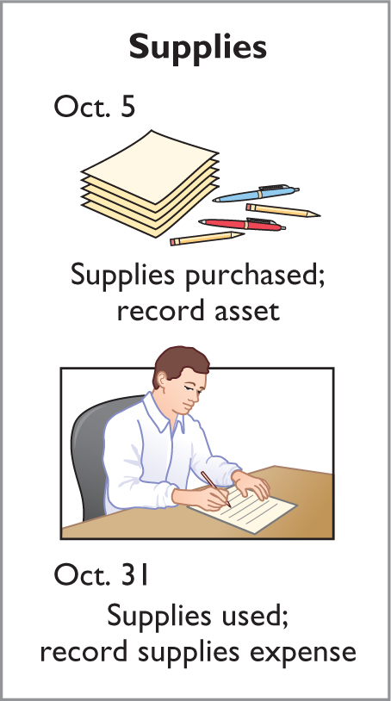
Supplies
Illustration: Yazici Advertising
purchased supplies costing ₺2,500 on October 5. Yazici recorded the payment by increasing (debiting) the asset Supplies. This account shows a balance of ₺2,500 in the October 31 trial balance. An inventory count at the close of business on October 31 reveals that ₺1,000 of supplies are still on hand.
Oct. 31
Supplies Expense 1,500
Supplies 1,500
LO 2

Slide 20
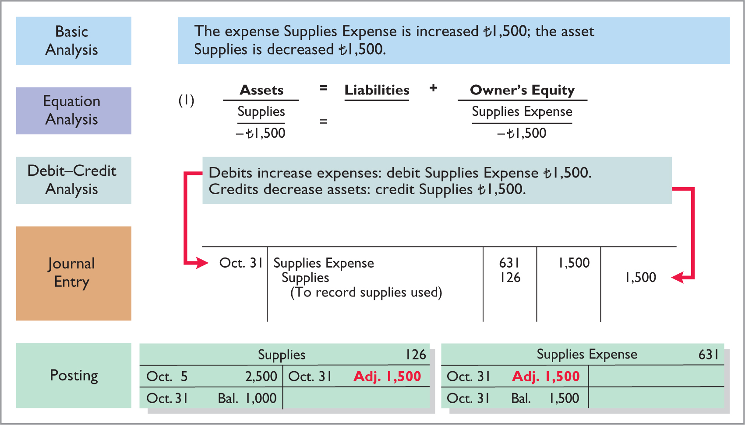
Supplies
ILLUSTRATION 3.5
Adjustment for supplies
LO 2

Slide 21
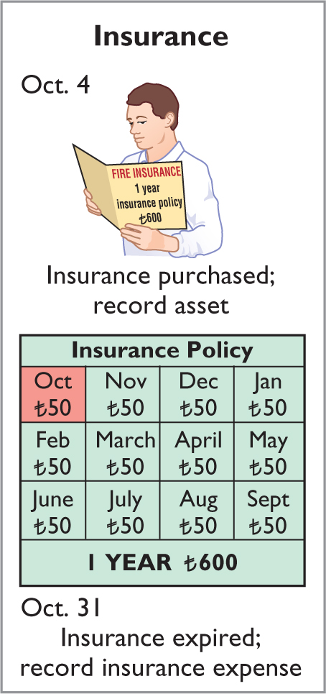
Insurance
Illustration: On October 4, Yazici Advertising paid ₺600 for a one-year fire insurance policy. Coverage began on October 1. Yazici recorded the payment by increasing (debiting) Prepaid Insurance. This account shows a balance of ₺600 in the October 31 trial balance. Insurance of ₺50 (₺600 ÷ 12) expires each month.
Oct. 31
Insurance Expense 50
Prepaid Insurance 50
LO 2

Slide 22
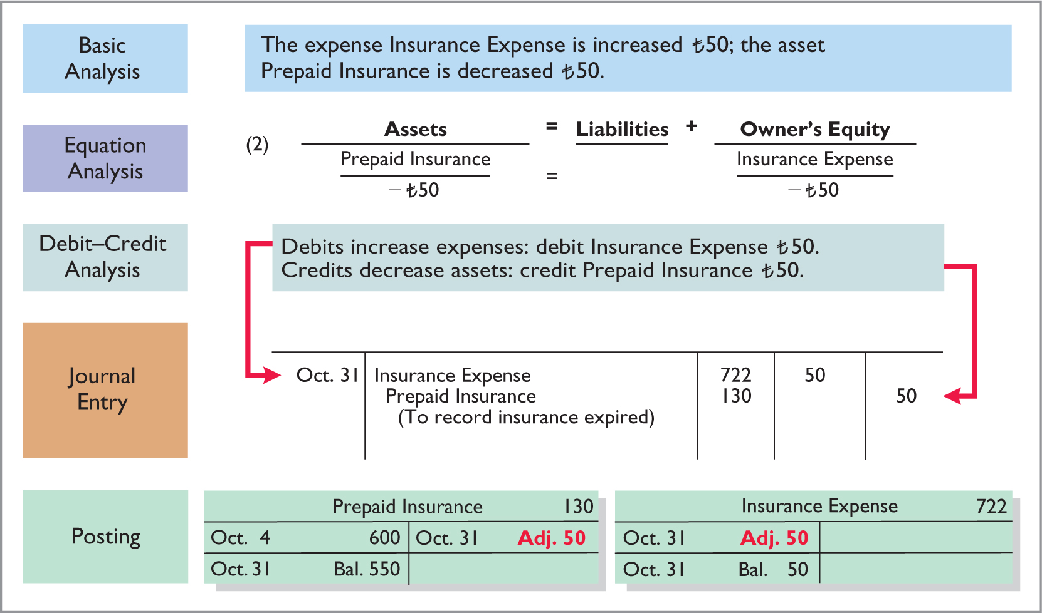
Insurance
ILLUSTRATION 3.6
Adjustment for insurance
LO 2

Slide 23
Depreciation
Buildings, equipment, and motor vehicles (assets that provide service for many years) are recorded as assets, rather than an expense, on the date acquired
Depreciation is the process of allocating the cost of an asset to expense over its useful life
Depreciation does not attempt to report the actual change in the value of the asset
Allocation concept, not a valuation concept
LO 2

Slide 24
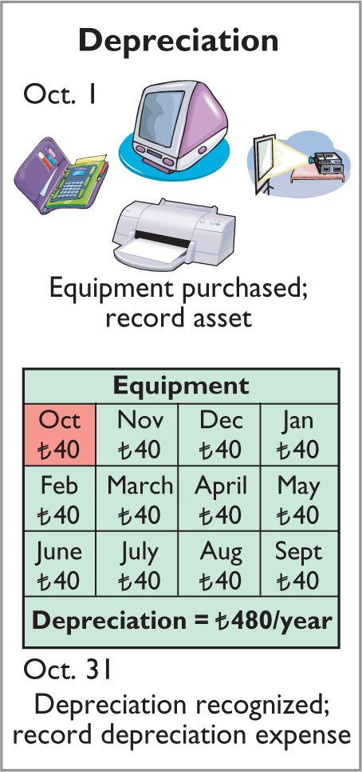
Depreciation
Illustration: For Yazici Advertising, assume that depreciation on the equipment is ₺480 a year, or ₺40 per month.
Oct. 31
Depreciation Expense 40
Accumulated Depreciation 40
Accumulated Depreciation is called a
contra asset account.
LO 2

Slide 25
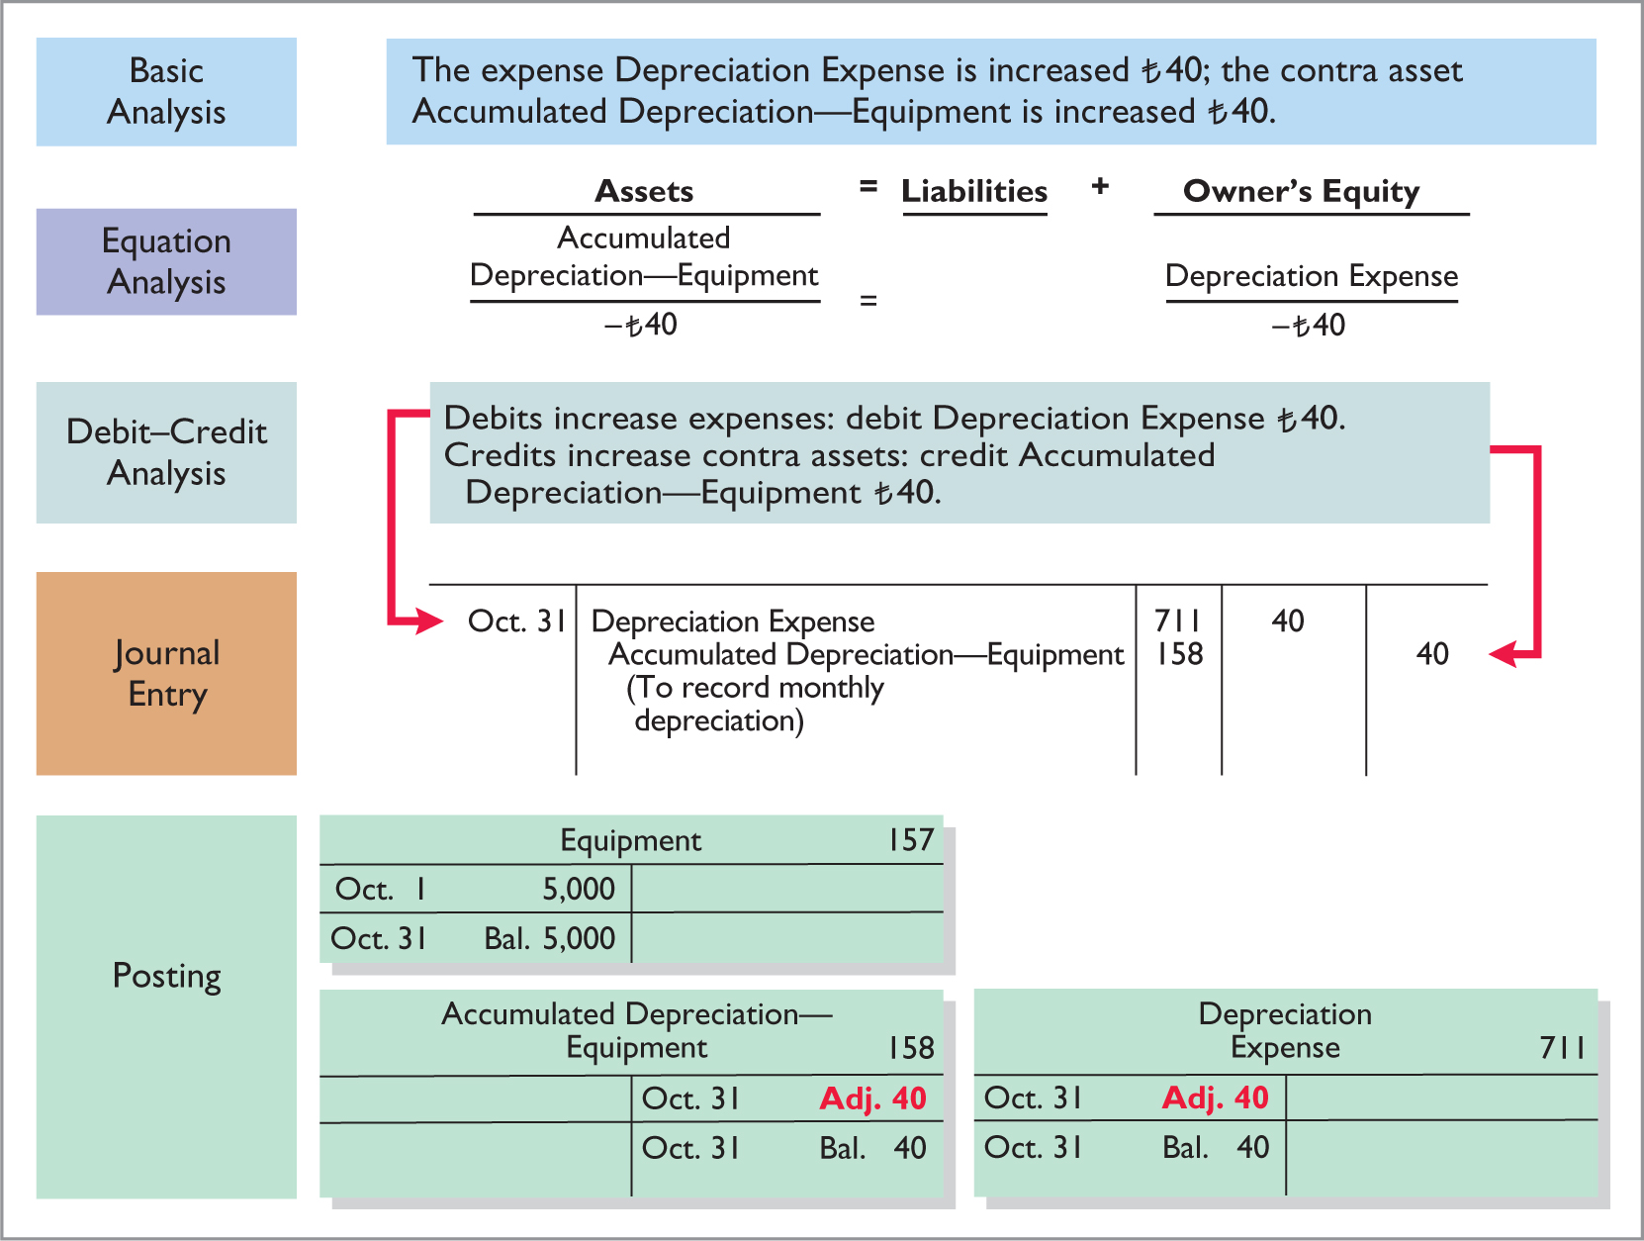
ILLUSTRATION 3.7
Adjustment for depreciation
LO 2

Slide 26
Depreciation
Statement Presentation
Accumulated Depreciation is a contra asset account (credit)
Offsets related asset account on the statement of financial position
Book value is the difference between the cost of any depreciable asset and its accumulated depreciation
Equipment | ₺5,000
Less: Accumulated depreciation—equipment | 40
 | ₺4,960
ILLUSTRATION 3.8
Statement of financial position presentation of accumulated depreciation
LO 2

Slide 27
Prepaid Expenses
Accounting for Prepaid Expenses
Examples | Reason for Adjustment | Accounts Before Adjustment | Adjusting Entry
Insurance, supplies, advertising, rent, depreciation | Prepaid expense originally recorded in asset accounts have been used. | Assets overstated. Expenses understated. | Dr. Expenses Cr. Assets or Contra Assets
ILLUSTRATION 3.9
Accounting for prepaid expenses
LO 2

Slide 28
Unearned Revenues
Receipt of cash that is recorded as a liability because the service has not been performed.
Cash Receipt
BEFORE
Revenue Recorded
Unearned revenues often occur in regard to:
Rent
Airline tickets
Magazine subscriptions
Customer deposits
LO 2

Slide 29
Unearned Revenues
Adjusting entry is made to record the revenue for services performed during the period and to show the liability that remains at the end of the period
Results in a decrease (debit) to a liability account and an increase (credit) to a revenue account
ILLUSTRATION 3.10
Liability
Revenue
Debit
Adjusting Entry (-)
Unadjusted
Balance
Credit
Adjusting Entry (+)
LO 2

Slide 30
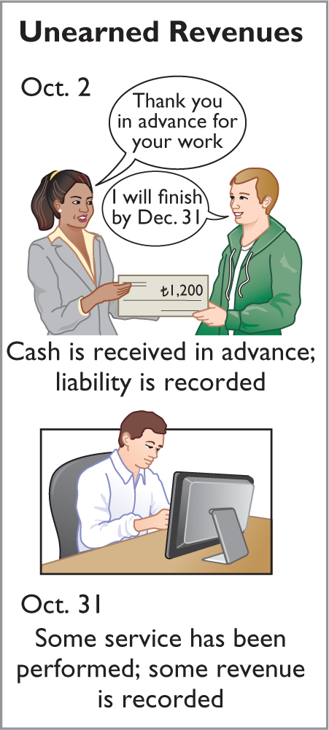
Unearned Revenues
Illustration: Yazici Advertising
received ₺1,200 on October 2 from R. Knox for advertising services expected to be completed by December 31. Unearned Service Revenue shows a balance of ₺1,200 in the October 31 trial balance. Analysis reveals that the company performed ₺400 of services in October.
Oct. 31
Unearned Service Revenue 400
Service Revenue 400
LO 2

Slide 31
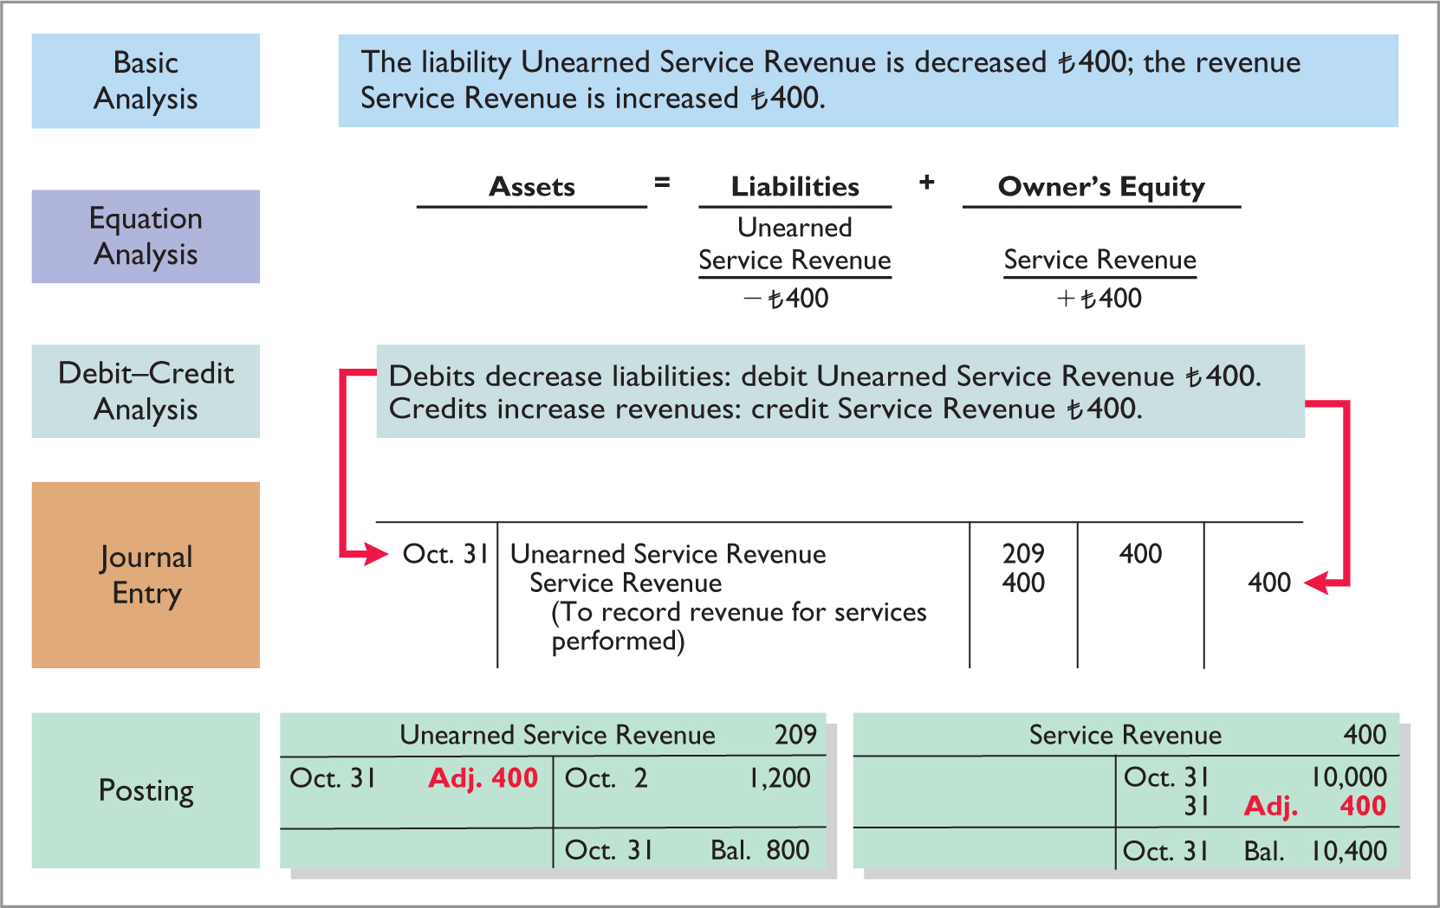
Unearned Revenues
ILLUSTRATION 3.11
Service revenue accounts after adjustment
LO 2

Slide 32
Unearned Revenues
ILLUSTRATION 3.12
Accounting for unearned revenues
Accounting for Unearned Revenues
Examples | Reason for Adjustment | Accounts Before Adjustment | Adjusting Entry
Rent, magazine subscriptions, customer deposits for future service | Unearned revenues recorded in liability accounts are now recognized as revenue for services performed. | Liabilities overstated. Revenues understated. | Dr. Liabilities Cr. Revenues
LO 2

Slide 33
DO IT! 2 Adjusting Entries for Deferrals
The ledger of Hammond Deliveries, on March 31, 2020, includes these selected accounts before adjusting entries are prepared.
Debit Credit
Prepaid Insurance € 3,600
Supplies 2,800
Equipment 25,000
Accumulated Depreciation—Equipment €5,000
Unearned Service Revenue 9,200
An analysis of the accounts shows the following.
Insurance expires at the rate of €100 per month.
Supplies on hand total €800.
The equipment depreciates €200 a month.
During March, services were performed for €4,000 of the unearned service revenue reported.
Prepare the adjusting entries for the month of March.
LO 2

Slide 34
DO IT! 2 Adjusting Entries for Deferrals
The ledger of Hammond Deliveries, on March 31, 2020, includes these selected accounts before adjusting entries are prepared.
Debit Credit
Prepaid Insurance € 3,600
Supplies 2,800
Equipment 25,000
Accumulated Depreciation—Equipment €5,000
Unearned Service Revenue 9,200
Prepare the adjusting entries for the month of March.
Insurance expires at the rate of €100 per month.
Insurance Expense 100
Prepaid Insurance 100
LO 2

Slide 35
DO IT! 2 Adjusting Entries for Deferrals
The ledger of Hammond Deliveries, on March 31, 2020, includes these selected accounts before adjusting entries are prepared.
Debit Credit
Prepaid Insurance € 3,600
Supplies 2,800
Equipment 25,000
Accumulated Depreciation—Equipment €5,000
Unearned Service Revenue 9,200
Prepare the adjusting entries for the month of March.
Supplies on hand total € 800.
Supplies Expense 2,000
Supplies 2,000
LO 2

Slide 36
DO IT! 2 Adjusting Entries for Deferrals
The ledger of Hammond Deliveries, on March 31, 2020, includes these selected accounts before adjusting entries are prepared.
Debit Credit
Prepaid Insurance € 3,600
Supplies 2,800
Equipment 25,000
Accumulated Depreciation—Equipment €5,000
Unearned Service Revenue 9,200
Prepare the adjusting entries for the month of March.
The equipment depreciates €200 a month.
Depreciation Expense 200
Accumulated Depreciation—Equipment 200
LO 2

Slide 37
DO IT! 2 Adjusting Entries for Deferrals
The ledger of Hammond Deliveries, on March 31, 2020, includes these selected accounts before adjusting entries are prepared.
Debit Credit
Prepaid Insurance € 3,600
Supplies 2,800
Equipment 25,000
Accumulated Depreciation—Equipment €5,000
Unearned Service Revenue 9,200
Prepare the adjusting entries for the month of March.
During March, services were performed for €4,000 of the unearned service revenue reported.
Unearned Service Revenue 4,000
Service Revenue 4,000
LO 2

Slide 38
Adjusting Entries for Accruals
Accruals are made to record,
Revenues for services performed but not yet recorded at the statement date
Expenses incurred but not yet paid or recorded at the statement date
Analyze
Journalize
Post
Trial Balance
Journalize and post adjusting entries: deferrals/accruals
Adjusted Trial Balance
Financial Statements
Closing Entries
Post-Closing Trial Balance
LO 3

Slide 39
Accrued Revenues
Revenues for services performed but not yet received in cash or recorded.
Revenue Recorded
BEFORE
Cash Receipt
Accrued revenues often occur in regard to:
Rent
Interest
Services
LO 3

Slide 40
Accrued Revenues
Adjusting entry records the receivable that exists and records the revenues for services performed.
Adjusting entry:
Increases (debits) an asset account and
Increases (credits) a revenue account
ILLUSTRATION 3.13
Asset
Revenue
Debit
Adjusting Entry (+)
Credit
Adjusting Entry (+)
LO 3

Slide 41
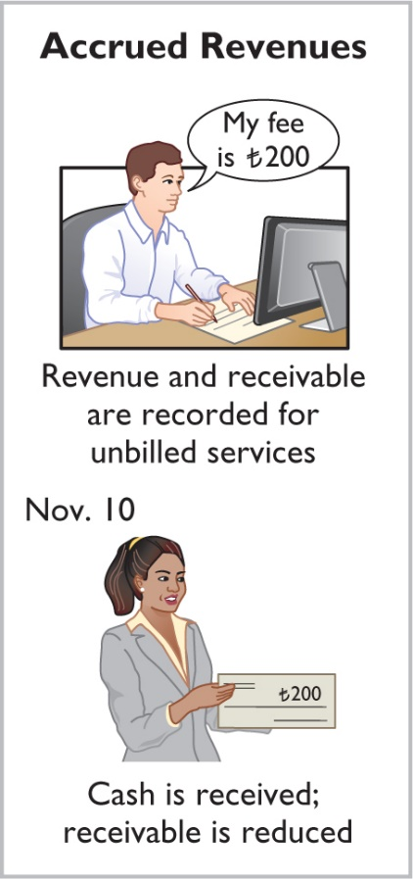
Accrued Revenues
Illustration: In October Yazici Advertising
performed services worth ₺200 that were
not billed to clients on or before October 31.
Oct. 31
Accounts Receivable 200
Service Revenue 200
On November 10, Pioneer receives cash of ₺200 for the services performed. The journal entry on the 10th is:
Cash 200
Accounts Receivable 200
LO 3

Slide 42
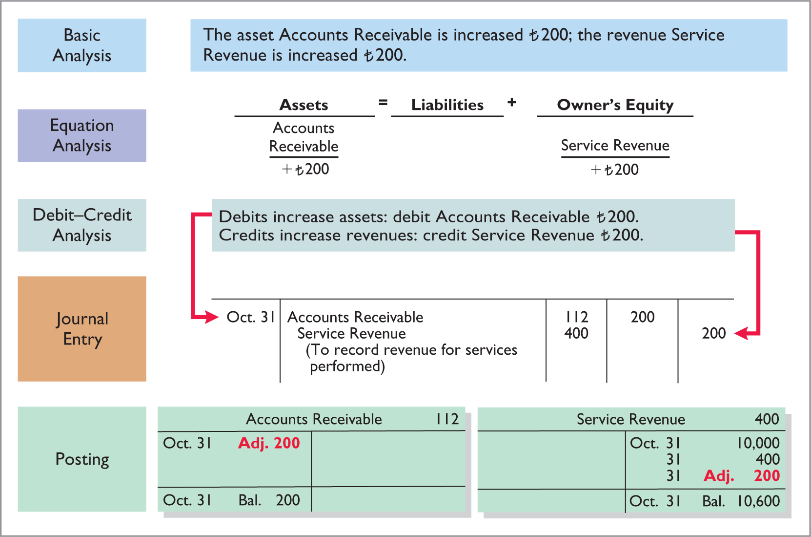
Accrued Revenues
ILLUSTRATION 3.14
Adjustments for accrued revenue
LO 3

Slide 43
Accrued Revenues
ILLUSTRATION 3.15
Accounting for accrued revenues
Accounting for Accrued Revenues
Examples | Reason for Adjustment | Accounts Before Adjustment | Adjusting Entry
Interest, rent, services | Services performed but not yet received in cash or recorded. | Assets understated. Revenues understated. | Dr. Assets Cr. Revenues
LO 3

Slide 44
Accrued Expenses
Expenses incurred but not yet paid in cash or recorded.
Expense Recorded
BEFORE
Cash Payment
Accrued expenses often occur in regard to:
Rent
Interest
Taxes
Salaries
LO 3

Slide 45
Accrued Expenses
Adjusting entry records the obligation and recognizes the expense.
Adjusting entry:
Increase (debit) an expense account and
Increase (credit) a liability account
ILLUSTRATION 3.16
Expense
Liability
Debit
Adjusting Entry (+)
Credit
Adjusting Entry (+)
LO 3

Slide 46
Accrued Expenses
Accrued Interest
Illustration: Yazici Advertising signed a three-month note payable in the amount of ₺5,000 on October 1. The note requires Yazici to pay interest at an annual rate of 12%.
Face Value of Note | x | Annual Interest Rate | x | Time in Terms of One Year | = | Interest
₺5,000 | x | 12% | x | 1/12 | = | ₺50
ILLUSTRATION 3.17
Oct. 31 Interest Expense 50
Interest Payable 50
LO 3

Slide 47
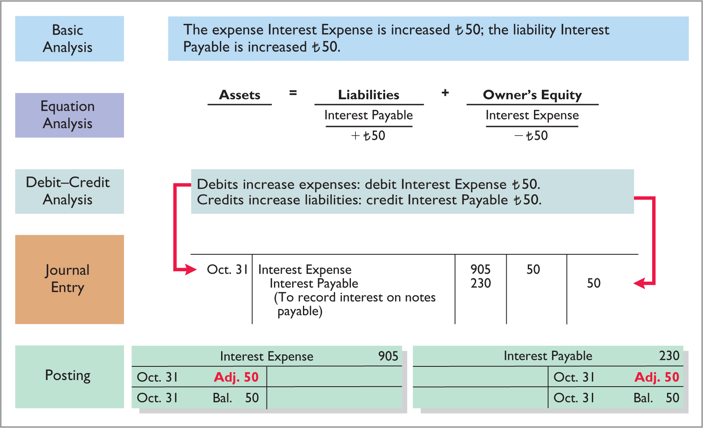
Accrued Expenses
ILLUSTRATION 3.18
Adjustment for accrued interest
LO 3

Slide 48
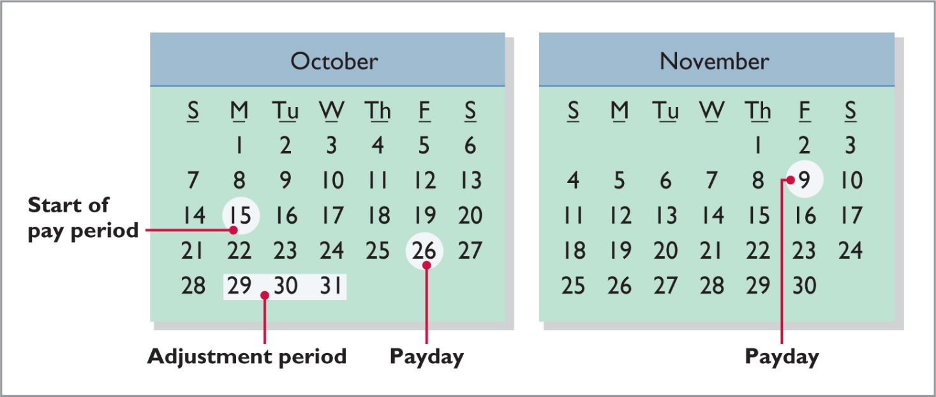
Accrued Expenses
Accrued Salaries and Wages
Illustration: Yazici Advertising paid salaries and wages on October 26; the next payment of salaries will not occur until November 9. The employees receive total salaries of ₺2,000 for a five-day work week, or ₺400 per day.
ILLUSTRATION 3.19
LO 3

Slide 49
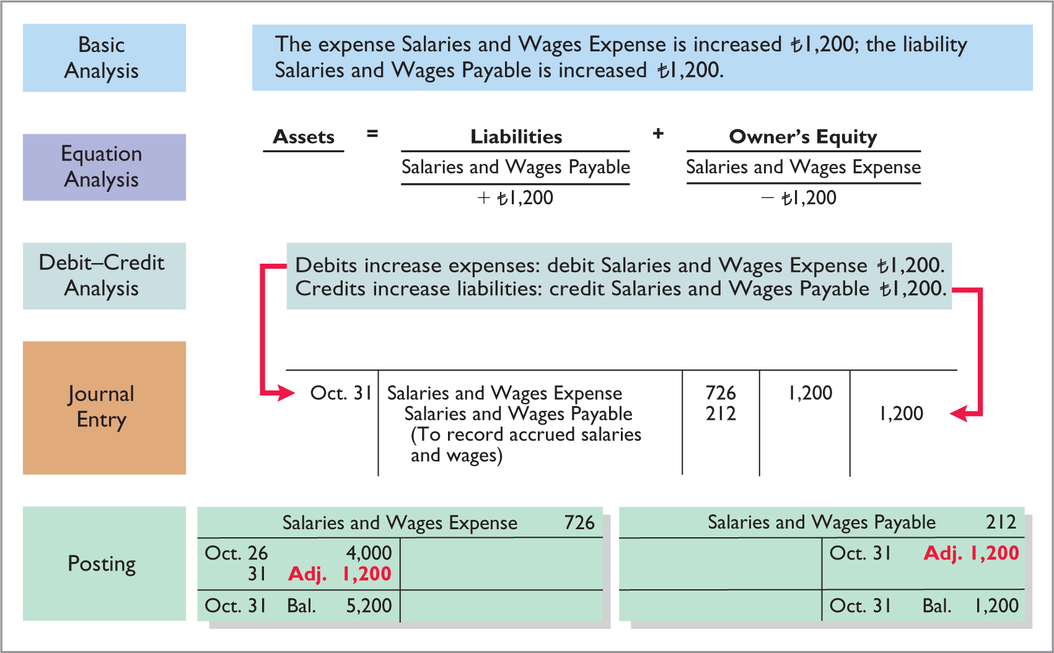
Accrued Expenses
ILLUSTRATION 3.20
Adjustment for accrued salaries and wages
LO 3

Slide 50
Accrued Expenses
After this adjustment, the balance in Salaries and Wages Expense of 5,200 (13 days × 400) is the actual salary and wages expense for October. The balance in Salaries and Wages Payable of 1,200 is the amount of the liability for salaries and wages Yazici owes as of October 31. Without the 1,200 adjustment for salaries and wages, Yazici's expenses are understated 1,200 and its liabilities are understated 1,200.
Yazici pays salaries and wages every two weeks. Consequently, the next payday is November 9, when the company will again pay total salaries and wages of 4,000. The payment consists of 1,200 of salaries and wages payable at October 31 plus 2,800 of salaries and wages expense for November (7 working days, as shown in the November calendar × 400). Therefore, Yazici makes the following entry on November 9.
Nov. 9
Dr. Salaries and Wages Payable 1,200
Dr. Salaries and Wages Expense 2,800
Cr. Cash 4,000
(To record November 9 payroll)

Slide 51
Accrued Expenses
ILLUSTRATION 3.21
Accounting for accrued expenses
Accounting for Accrued Revenues
Examples | Reason for Adjustment | Accounts Before Adjustment | Adjusting Entry
Interest, rent, salaries | Expenses have been incurred but not yet paid in cash or recorded. | Expenses understated. Liabilities understated. | Dr. Expenses Cr. Liabilities
LO 3

Slide 52
Summary of Basic Relationships
ILLUSTRATION 3.22
Summary of adjusting entries
Type of Adjustment | Accounts Before Adjustment | Adjusting Entry
Prepaid expenses | Assets overstated. Expenses understated. | Dr. Expense Cr. Assets or Contra Assets
Unearned revenues | Liabilities overstated. Revenues understated. | Dr. Liabilities Cr. Revenues
Accrued revenues | Assets understated. Revenues understated. | Dr. Assets Cr. Revenues
Accrued expenses | Expenses understated. Liabilities understated. | Dr. Expenses Cr. Liabilities
LO 3

Slide 53
DO IT! 3 Adjusting Entries Accruals
Mahindra Computer Services began operations on August 1, 2020. At the end of August 2020, management prepares monthly financial statements. The following information relates to August (amounts in thousands).
At August 31, the company owed its employees INR800 in salaries and wages that will be paid on September 1.
On August 1, the company borrowed INR30,000 from a local bank on a 15-year mortgage. The annual interest rate is 10%.
Revenue for services performed but unrecorded for August totaled INR1,100.
Prepare the adjusting entries needed at August 31, 2020.
LO 3

Slide 54
DO IT! 3 Adjusting Entries Accruals
Prepare the adjusting entries needed at August 31, 2020.
At August 31, the company owed its employees INR800 in salaries and wages that will be paid on September 1.
Salaries and Wages Expense 800
Salaries and Wages Payable 800
On August 1, the company borrowed INR30,000 from a local bank on a 15-year mortgage. The annual interest rate is 10%.
Interest Expense 250
Interest Payable 250
LO 3

Slide 55
DO IT! 3 Adjusting Entries Accruals
Prepare the adjusting entries needed at August 31, 2020.
Revenue for services performed but unrecorded for August totaled INR1,100.
Accounts Receivable 1,100
Service Revenue 1,100
LO 3

Slide 56
Adjusted Trial Balance
Prepared after adjusting entries are journalized and posted
Proves equality of debit and credit balances
Basis for the preparation of financial statements
Analyze
Journalize
Post
Trial Balance
Adjusting Entries
Adjusted Trial Balance
Prepare
Financial Statements
Journalize and Post Closing Entries
Post-Closing Trial Balance
LO 4

Slide 57
Yazici Advertising Adjusted Trial Balance October 31, 2020
 | Debit |  | Credit
Cash | ₺15,200
Accounts Receivable | 200
Supplies | 1,000
Prepaid Insurance | 550
Equipment | 5,000
Accumulated Depreciation |  |  | ₺ 40
Notes Payable |  |  | 5,000
Accounts Payable |  |  | 2,500
Unearned Service Revenue |  |  | 800
Salaries and Wages Payable |  |  | 1,200
Interest Payable |  |  | 50
Owner’s Capital |  |  | 10,000
Owner’s Drawings | 500
Service Revenue |  |  | 10,600
Salaries and Wages Expense | 5,200
Supplies Expense | 1,500
Rent Expense | 900
Insurance Expense | 50
Interest Expense | 50
Depreciation Expense | 40
 | ₺30,190 |  | ₺30,190
ILLUSTRATION 3.25
LO 4

Slide 58
Adjusted Trial Balance
Which of the following statements is incorrect concerning the adjusted trial balance?
An adjusted trial balance proves the equality of the total debit balances and the total credit balances in the ledger after all adjustments are made.
The adjusted trial balance provides the primary basis for the preparation of financial statements.
The adjusted trial balance lists the account balances segregated by assets and liabilities.
The adjusted trial balance is prepared after the adjusting entries have been journalized and posted.
LO 4

